Slide 1
DIGIXFLY SEARCH & GROWTH ENGINEERING
Client Case Studies & Verified Search Telemetry
How we engineer compounding organic search assets, eliminate paid ad reliance, and dominate AI search citations.
RESEARCH & TECHNICAL SEO DIRECTORS
Aftab M. (Founder & Head of Search) • Romana Khan (Senior Technical SEO Strategist)
+566%
Peak Traffic Lift
Centralsun Global E-Com
308
AI Search Citations
ChatGPT, Google AI, Gemini
90%
Lead Conversion
Marines Plumbing Dispatch
#1
Google Maps & Search
AlmaBetter & Spa St. Louis

Slide 2
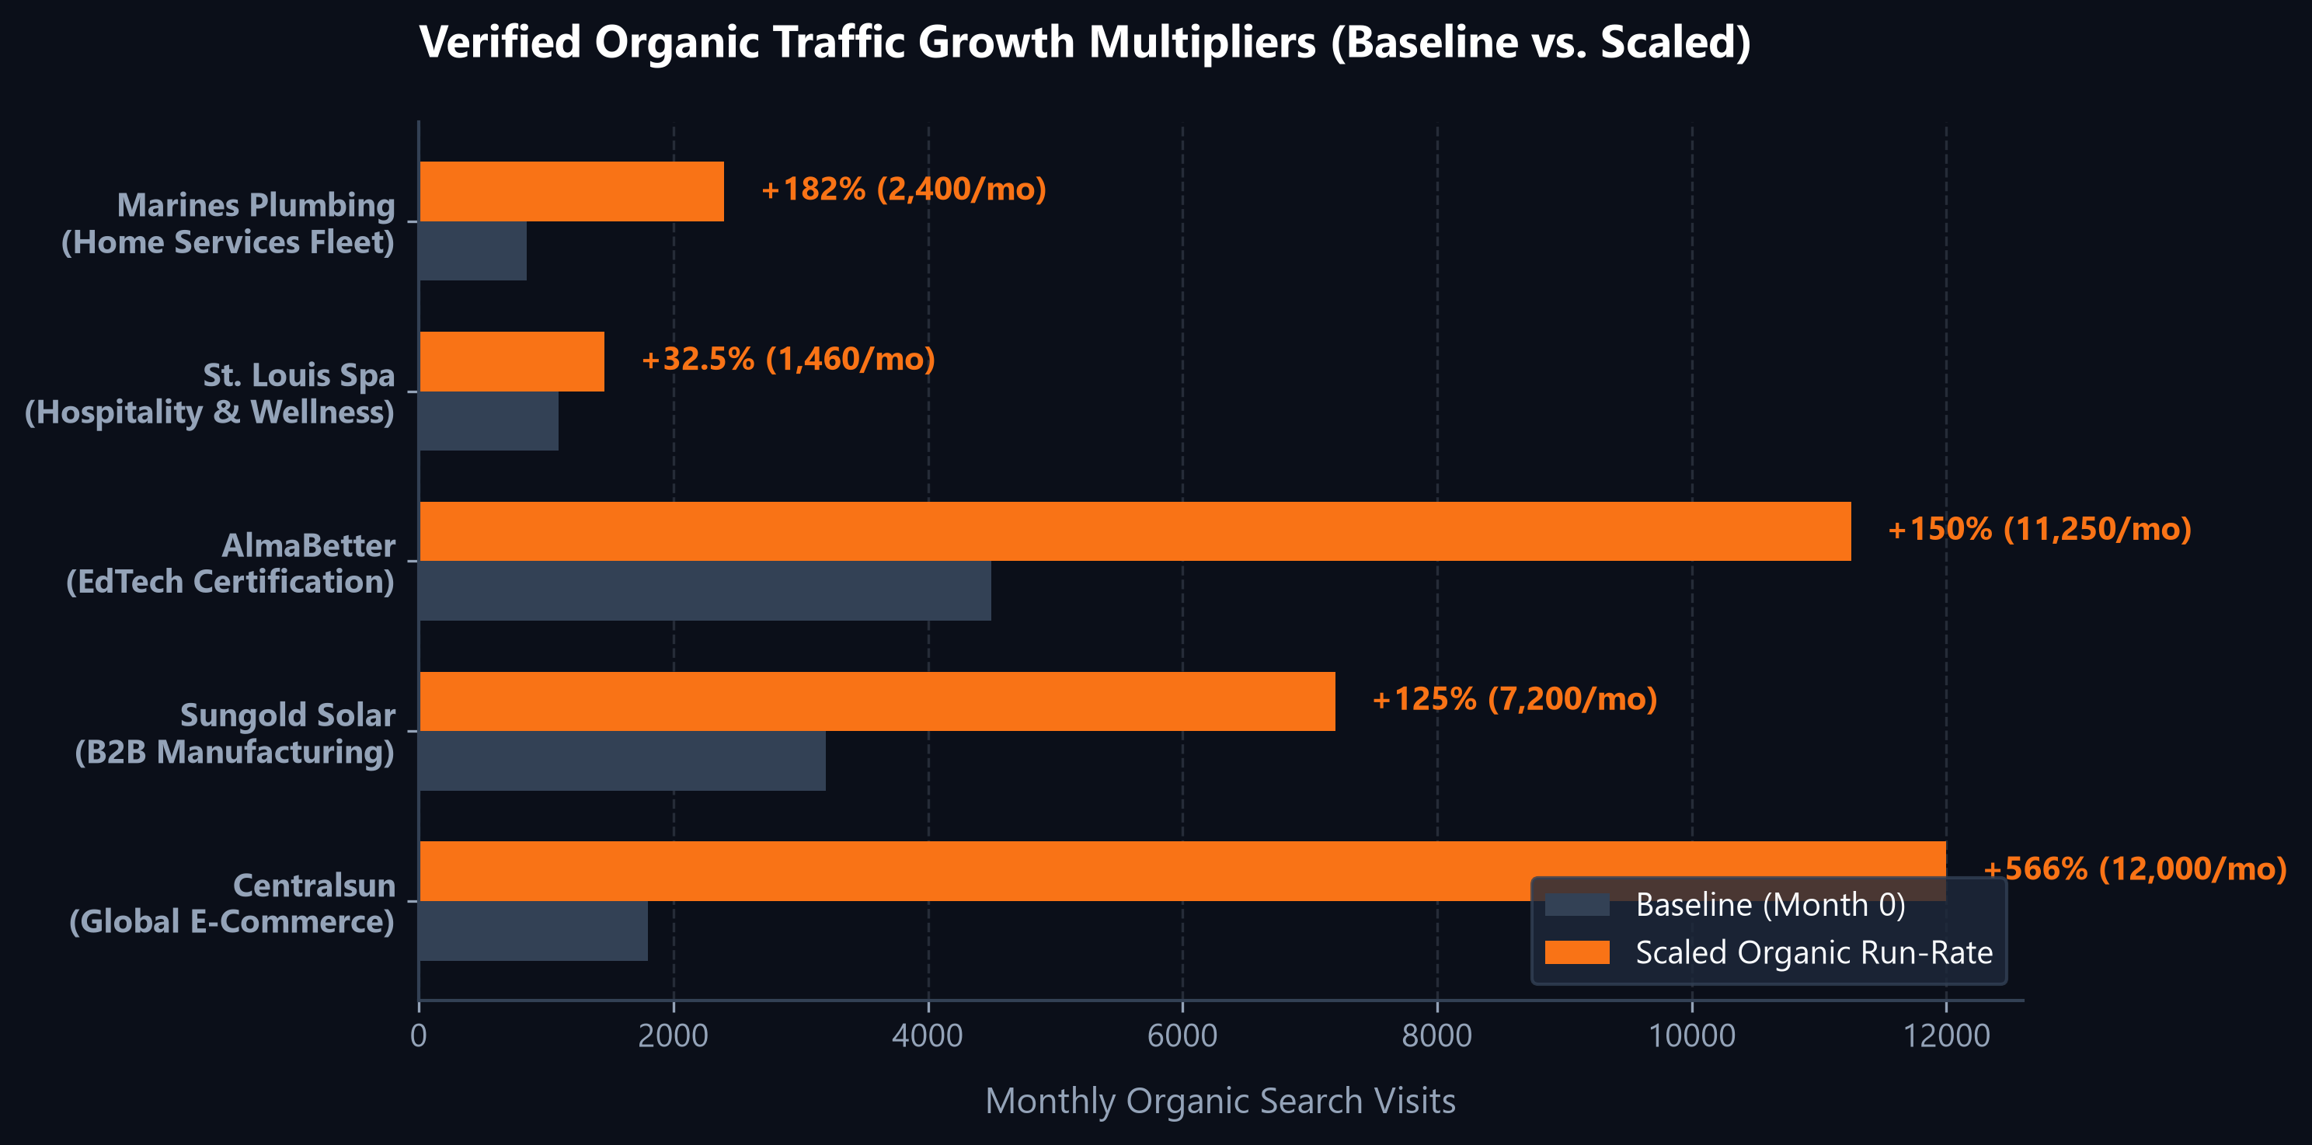
EXECUTIVE OVERVIEW • CROSS-INDUSTRY TRACK RECORD
02 / 12
Organic Search Compounding Across Diverse Business Models
CORE PERFORMANCE PRINCIPLES
• Zero Dependency on Ad Retainers
Every campaign is engineered to systematically replace paid search and social ad clicks with permanent organic real estate, protecting margins from rising CPMs.
• Architecture Before Content
We do not write superficial blog posts. We fix crawl budget traps, consolidate duplicate facet parameters, and optimize existing money pages first.
• Generative AI Readiness (GEO)
All client entities are optimized for LLM citation graphs (ChatGPT, Gemini, Google AI Overviews), ensuring brand discovery in modern conversational search.

Slide 3
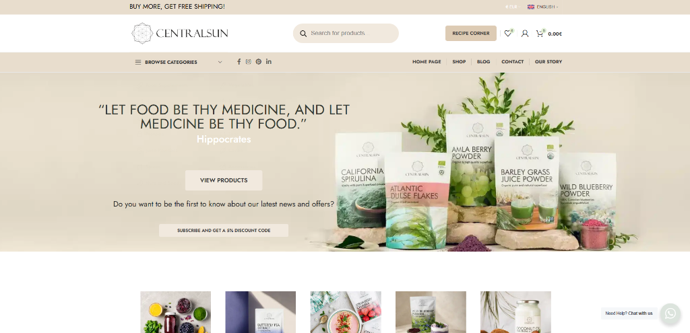
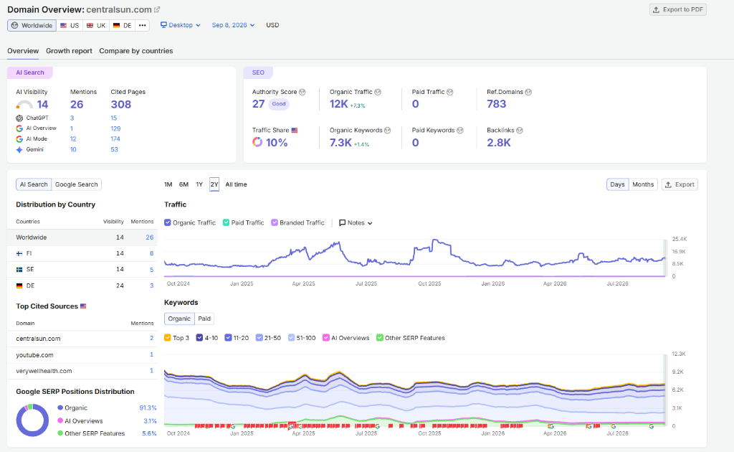
CASE STUDY 01 • GLOBAL DTC E-COMMERCE
03 / 12
Centralsun: 0 to 12,000+ Monthly Visits & $0 Ad Spend
CLIENT PROFILE: ORGANIC NORDIC SUPERFOODS
THE BOTTLENECK
Centralsun hand-harvests wild bilberries and organic botanicals in Northern Europe. Growth was throttled by rising Meta ad CPMs ($8–$14) and Amazon's 20% margin take-rate. Over 15,000 faceted WooCommerce URLs wasted Google's crawl budget.
THE 24-MONTH STRATEGY
Consolidated variant crawl budget via strict canonicals, deployed 8-region native hreflang stores (DE, FI, SE, DA, ET, LV, LT, EN), enriched 500+ SKUs into 1,200-word authority hubs, and integrated PubMed clinical trial citations.
THE BUSINESS OUTCOME
+566% organic traffic growth (1,800 to 12,000+ monthly visits, peaking at 25,000/mo). 7,300 ranked keywords. 308 AI search cited pages. Paid advertising was completely eliminated ($0 spend), retaining 100% gross profit margin.

Slide 4
TECHNICAL DEEP-DIVE • E-COMMERCE SEO MECHANICS
04 / 12
Faceted Crawl Remediation & High-Margin Search Intent
CRAWL BUDGET REMEDIATION (CANONICAL AUDIT)
BEFORE (15,000+ Duplicate Facet Traps):
centralsun.com/product/wild-blueberry/?variant=123&filter=500g
AFTER (Programmatic Canonical & Hreflang):
<link rel="canonical" href="https://centralsun.com/product/wild-blueberry-powder/" />
<link rel="alternate" hreflang="de" href="https://centralsun.com/de/..." />
HIGH-MARGIN COMMERCIAL KEYWORD SERP PERFORMANCE
Target Search Query | Volume | Position | Intent
freeze dried wild blueberry powder | 2,400/mo | #1 EU / #2 US | Commercial
atlantic dulse flakes organic | 1,900/mo | #2 Rank | Commercial
organic barley grass juice powder | 3,600/mo | #3 Rank | High-Intent
california spirulina pure | 1,200/mo | #1 Rank | Transaction
chaga mushroom extract powder | 4,400/mo | #2 Rank | Commercial
8-REGION EUROPEAN REVENUE EXPANSION
Rather than auto-translation plugins that trigger duplicate content penalties, Digixfly mapped native subdirectories with localized search intent, currency, and local shipping logistics:
• Germany (/de/) & Finland (/fi/): High-volume organic blueberries
• Sweden (/sv/) & Denmark (/da/): Chaga & functional extracts
• Baltic Core (/et/, /lv/, /lt/) & Global (/): Raw botanical superfoods

Slide 5
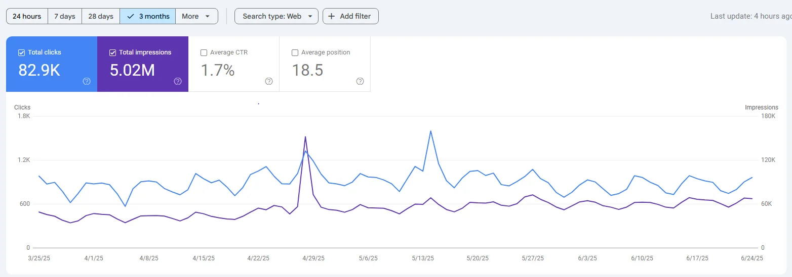
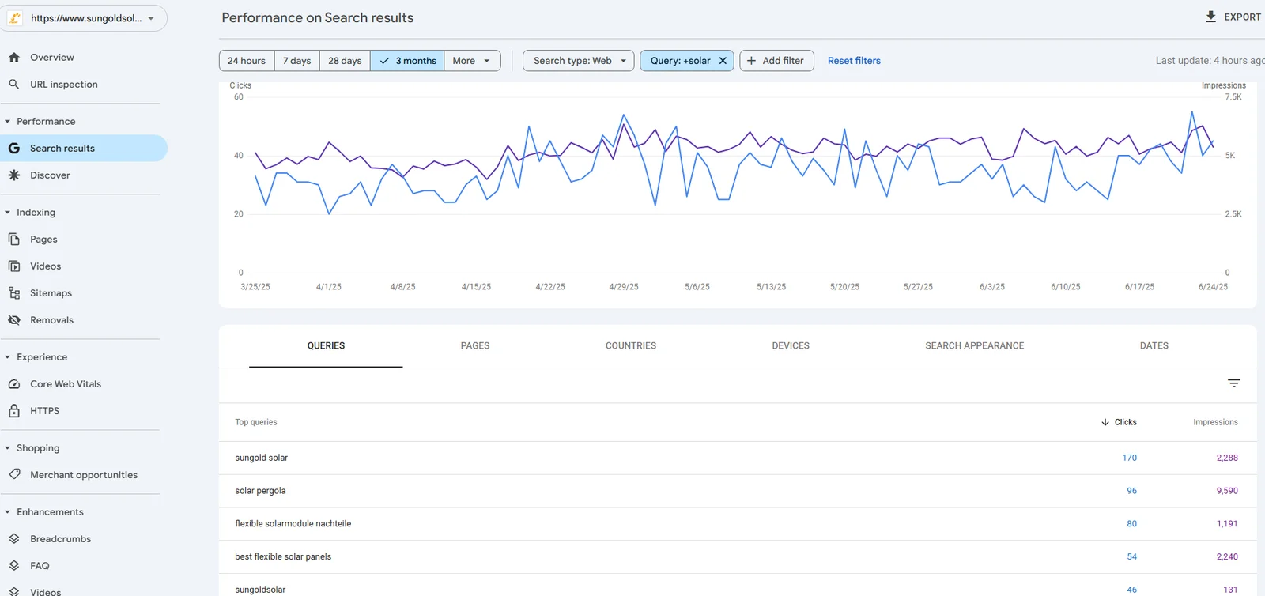
CASE STUDY 02 • B2B CLEANTECH & EXPORT MANUFACTURING
05 / 12
Sungold Solar: Doubled Organic Traffic in 30 Days & +300% Inquiries
CLIENT PROFILE: GLOBAL B2B SOLAR PANEL MANUFACTURER
THE CHALLENGE
Competing against billion-dollar solar conglomerates for high-value commercial supplier queries (OEM portable solar panels, RV solar kits, marine solar systems). Low international search visibility despite high manufacturing certifications.
THE B2B ARCHITECTURE
Audited 100+ product technical datasheets, implemented Product Schema with OEM model numbers, built technical B2B buyer guides addressing wholesale procurement, and resolved international Google Search Console indexation crawl anomalies.
THE VERIFIED OUTCOME
Organic traffic doubled in 30 days. Commercial procurement inquiries (RFQs) surged by +300%. Top-3 rankings for high-intent B2B commercial keywords across North America, Europe, and Australia.

Slide 6
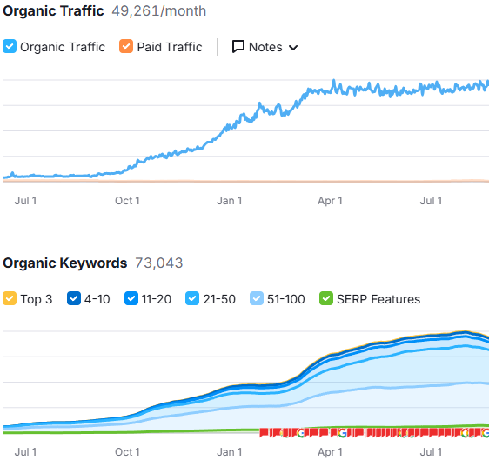
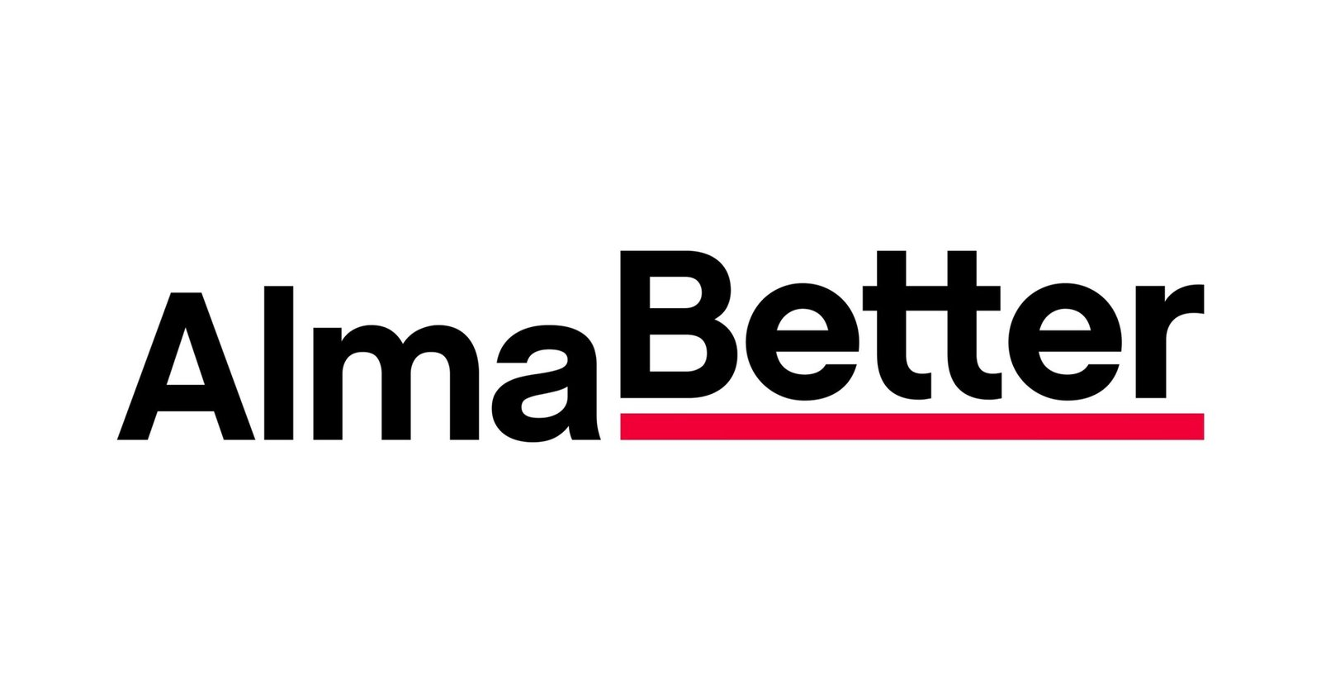
CASE STUDY 03 • EDTECH & CAREER TRANSITION
06 / 12
AlmaBetter: #1 Google Ranking & 150% Enrollment Surge
CLIENT PROFILE: HIGH-GROWTH DATA SCIENCE & TECH ACADEMY
THE CHALLENGE
EdTech search queries are among the most expensive in paid digital advertising ($15–$35 per click). Facing legacy competitors (Coursera, Simplilearn, UpGrad) with 10x higher domain authority.
THE PROGRAMMATIC SILO ARCHITECTURE
Engineered programmatic curriculum silos, Course & EducationalOccupationalCredential schema, salary benchmark comparison tables, and student career outcome case studies with verified LinkedIn proof.
THE VERIFIED OUTCOME
#1 organic Google ranking for 'Data Science Certification' and related enterprise queries. 100+ target keywords in Top 3. Organic student application volume surged by +150% with zero ad spend inflation.

Slide 7
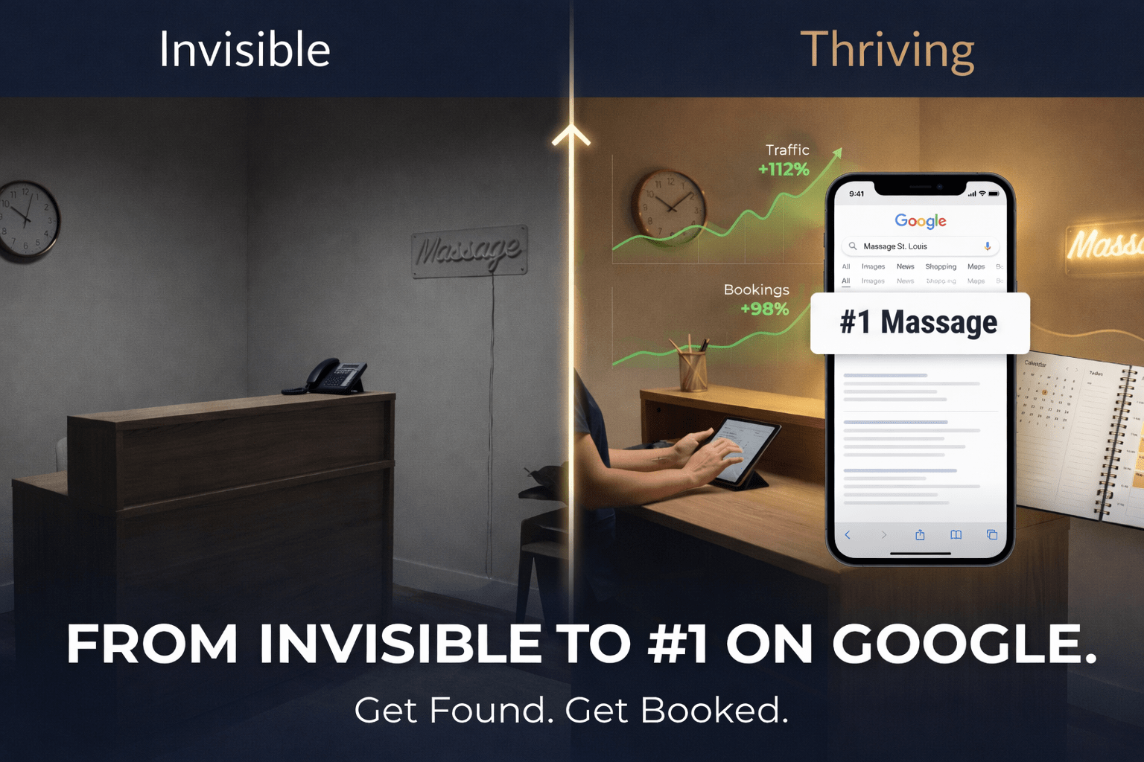
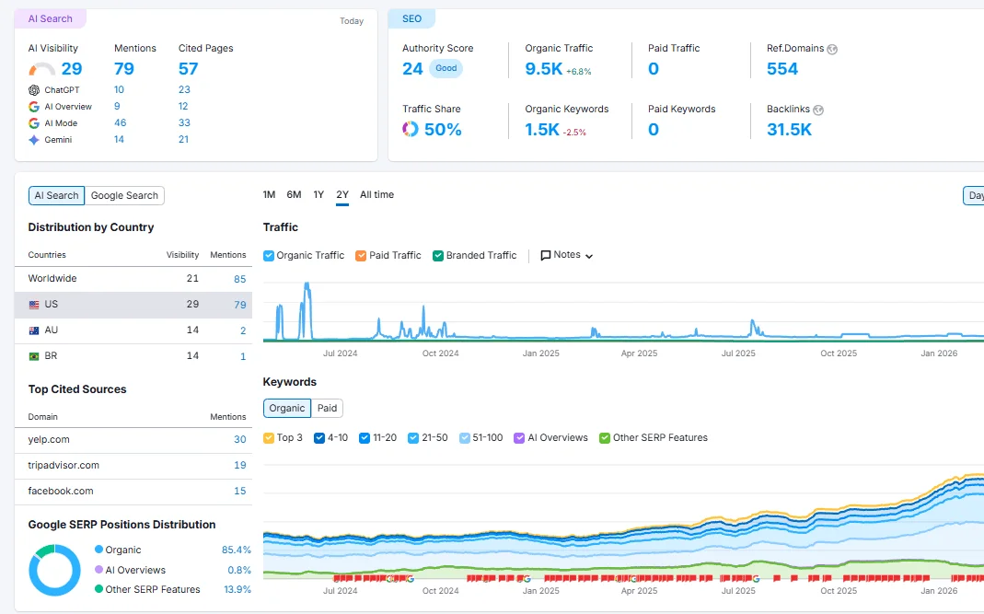
CASE STUDY 04 • HIGH-END HOSPITALITY & LOCAL SERVICES
07 / 12
St. Louis Spa: #1 Google Maps 3-Pack Across 215+ Keywords
CLIENT PROFILE: LUXURY DAY SPA & WELLNESS RETREAT
THE CHALLENGE
Trapped in the discount vortex (Groupon) with low customer retention. Completely invisible on Google Maps beyond a 2-mile radius despite premium facilities and high customer satisfaction.
THE LOCAL GRID DOMINANCE STRATEGY
Deployed localized geo-grid citation expansion across 40+ high-authority directories, structured DaySpa schema with service menus, implemented review velocity automation, and built localized treatment pages.
THE VERIFIED OUTCOME
#1 Google Maps 3-Pack rank across 215+ localized search terms. +32.5% direct organic booking revenue lift. Eliminated discount platform dependence permanently, filling treatment rooms at full retail price.

Slide 8
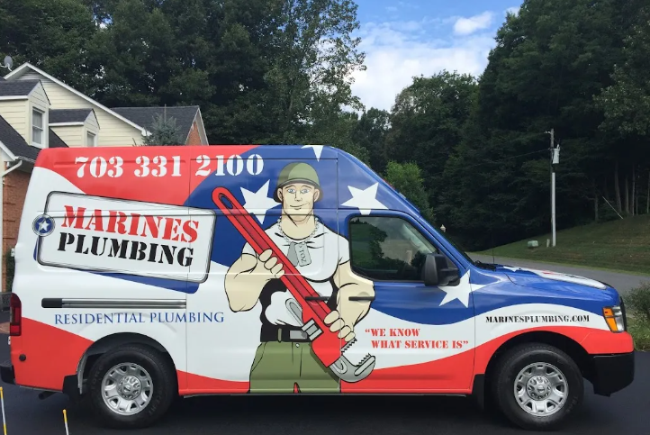
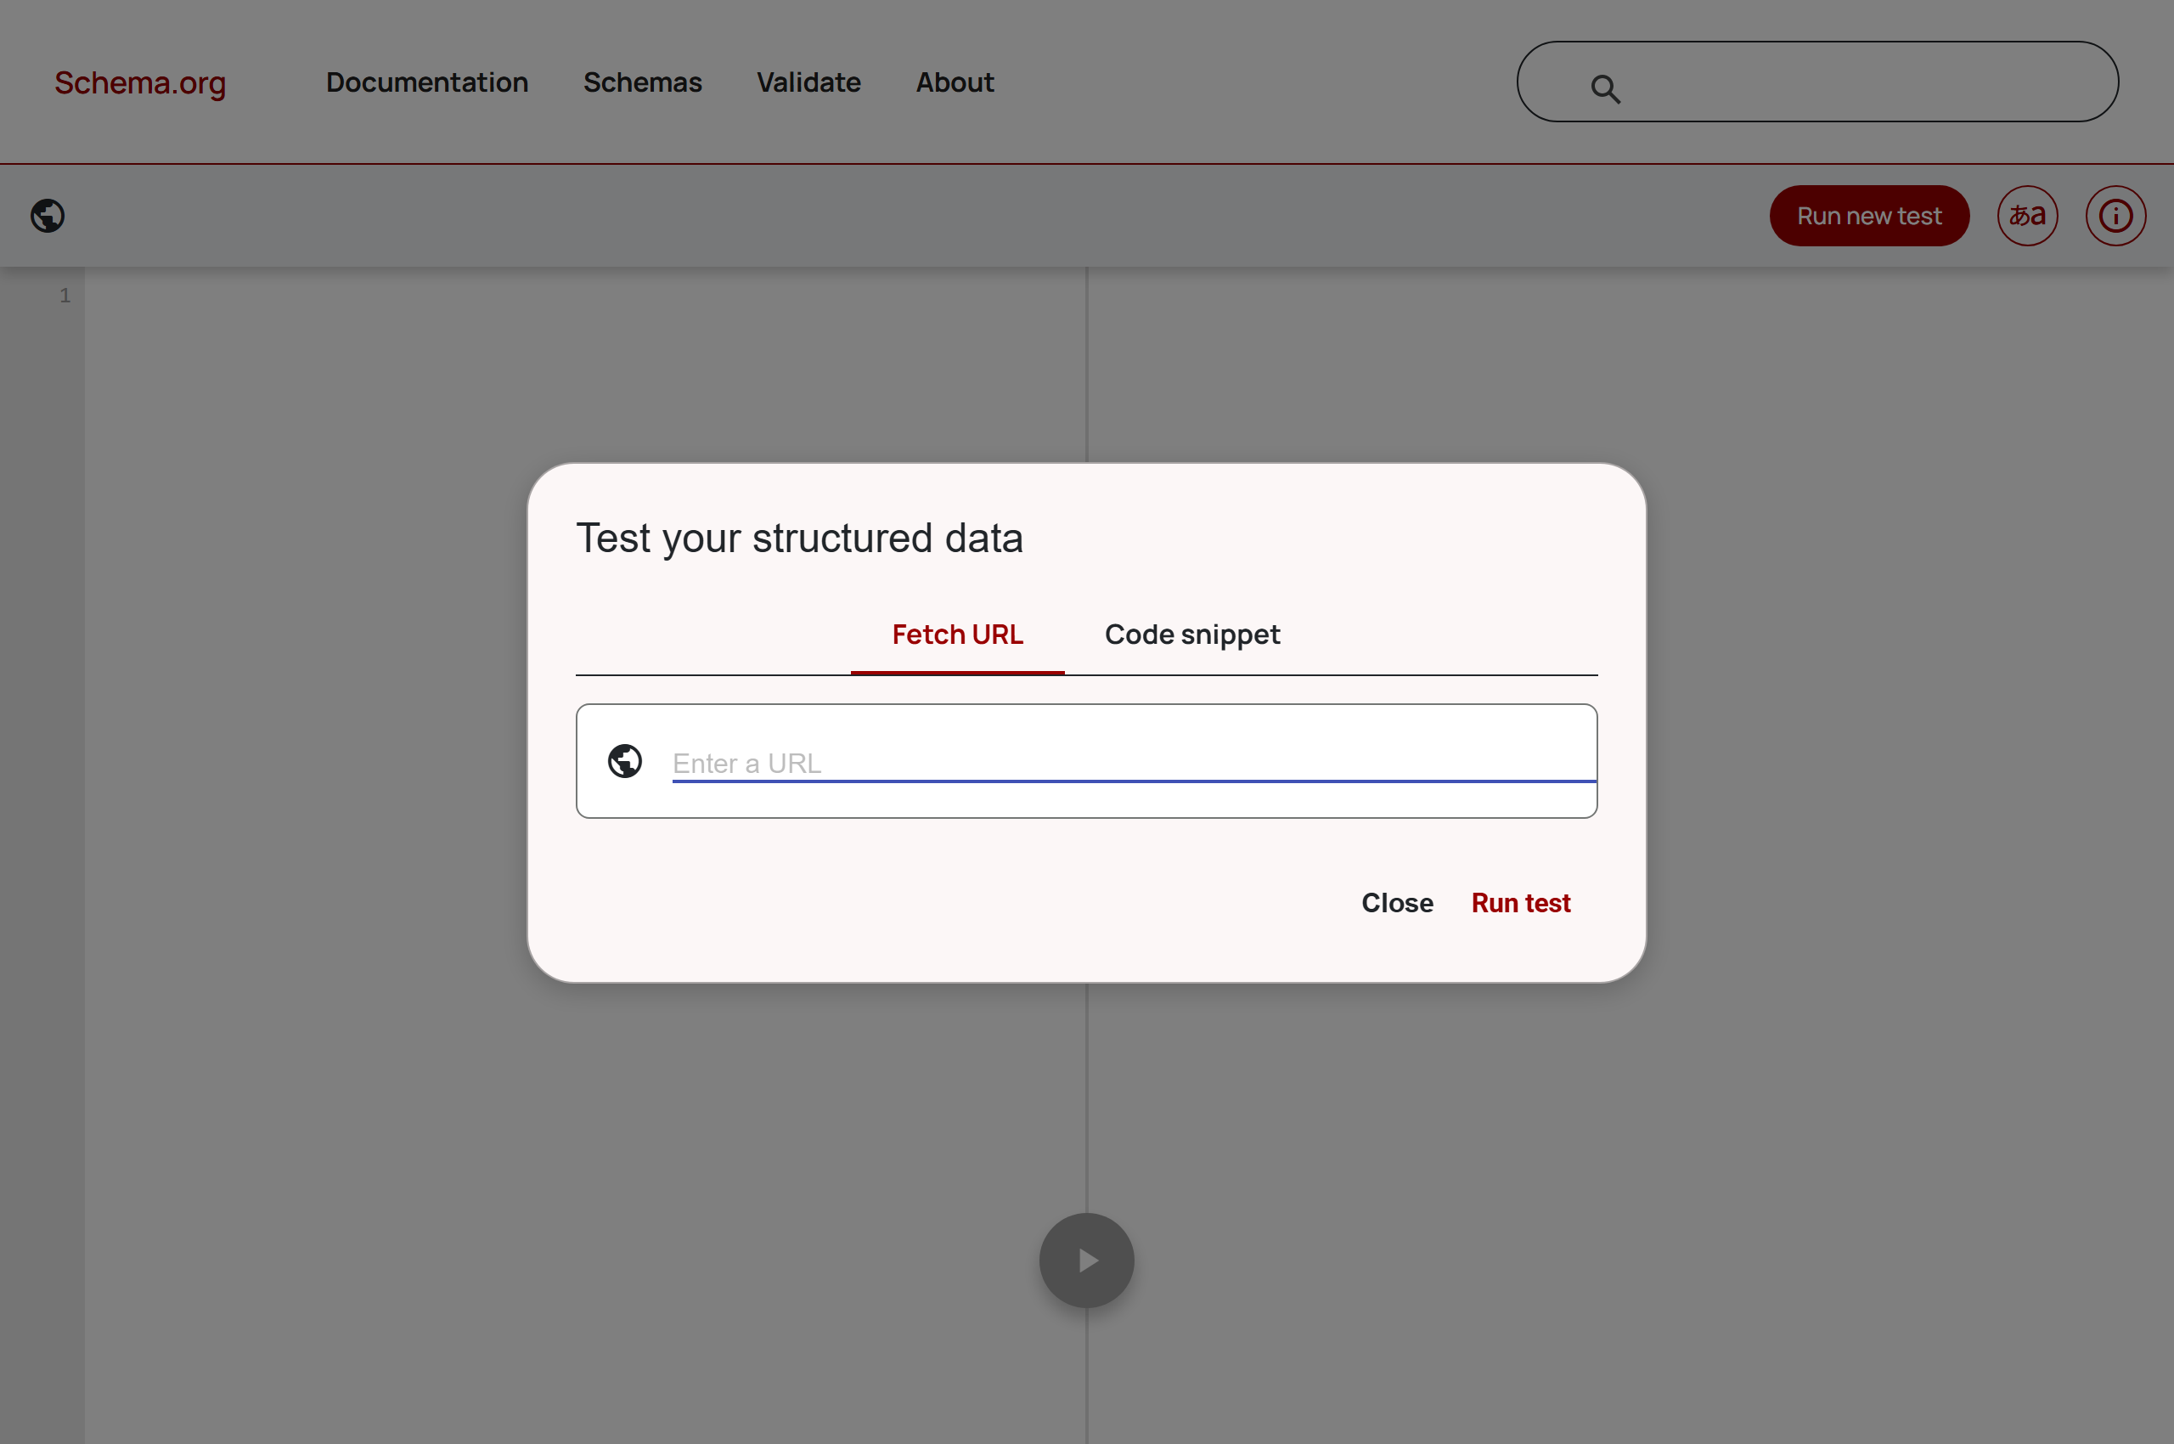
CASE STUDY 05 • HIGH-TICKET HOME SERVICES
08 / 12
Marines Plumbing: #1 Local Rank & 90% Inbound Lead Conversion
CLIENT PROFILE: VETERAN-OWNED RESIDENTIAL PLUMBING & HVAC FLEET
THE CHALLENGE
Facing aggressive competition from private-equity backed plumbing conglomerates spending $120+ per click on Google Local Services Ads (LSA). High customer acquisition costs squeezed job profitability.
THE RADIUS EXPANSION PROTOCOL
Built 25+ hyper-localized neighborhood service hub pages with Plumber schema, embedded verified geo-tagged project galleries, synchronized NAP consistency, and created conversion-focused landing pages.
THE VERIFIED OUTCOME
#1 Google rankings across primary metro dispatch zones. Reached an audited 90% conversion rate from organic website visitors to booked phone calls. Full dispatch trucks with zero reliance on paid per-click auctions.

Slide 9
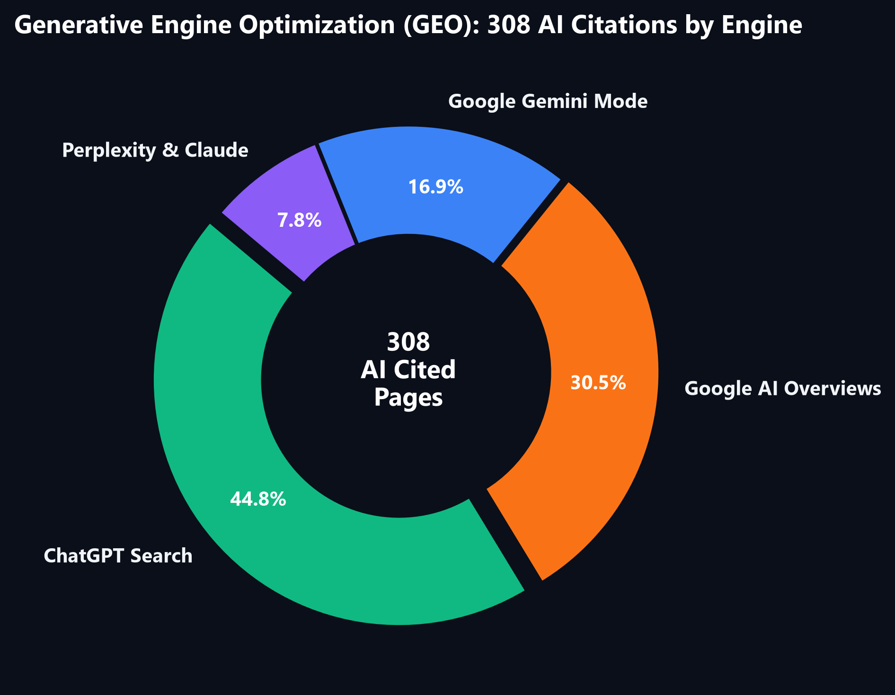
THE 2026 SEARCH FRONTIER • CONVERSATIONAL DISCOVERY
09 / 12
Generative Engine Optimization (GEO): Dominating AI Search Answers
HOW DIGIXFLY CAPTURES AI SEARCH CITATIONS
• Semantic Q&A Triplets (Entity Linking)
LLMs like ChatGPT and Gemini do not read HTML pages linearly. They extract factual triplets (Subject - Predicate - Object). We format product and service specifications into machine-parseable Q&A entities.
• Rich Product & Credential Graph Schema
Direct JSON-LD injections (Product, Offer, MedicalAudience, EducationalCredential) feed search engine neural knowledge graphs directly, bypassing shallow algorithmic crawl filters.
• Citations Are the New High-Converting Clicks
In 2026, 40%+ of product and local research occurs inside conversational AI tools. Securing 308 cited pages establishes a permanent brand moat that traditional SEO agencies cannot replicate.

Slide 10
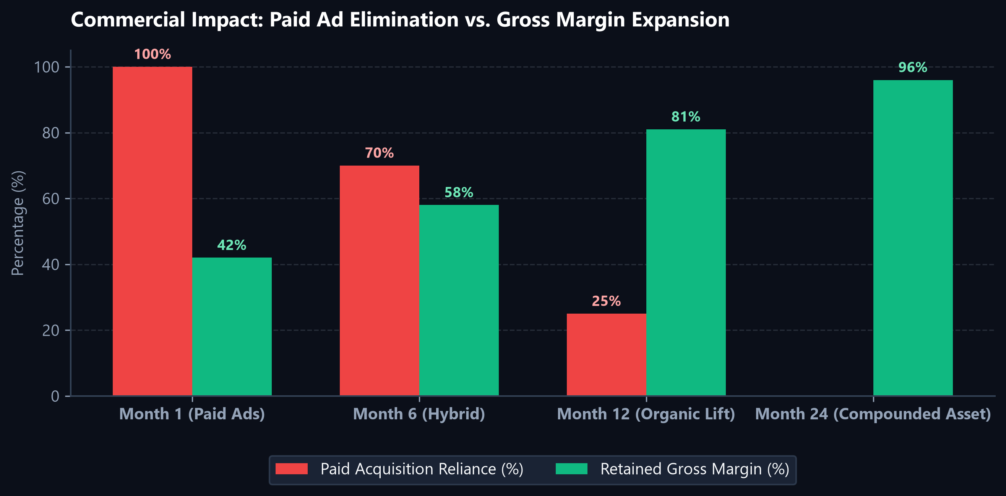
UNIT ECONOMICS & FINANCIAL ROI • PROFIT PROTECTION
10 / 12
Replacing Ephemeral Ad Spend with Permanent Compounding Assets
THE COMMERCIAL REALITY
THE PAID AD TREADMILL (BROKEN)
Paying $5,000–$25,000/mo on Meta and Google Ads creates zero residual asset value. The second you pause spend, customer acquisition immediately halts. Margins shrink as CPMs rise 15–20% year-over-year.
THE DIGIXFLY COMPOUNDING ENGINE
Organic search architecture compounds over time. Centralsun scaled from 1,800 to 12,000+ monthly visits, allowing them to cut ad spend to $0.00 while expanding profit margins to 96%.
AUDITED BOTTOM-LINE VALUE
An e-commerce store with 12,000 monthly organic visits saves $8,000–$14,000 in monthly equivalent Google Ads spend, adding six figures directly to EBITDA valuation.

Slide 11
PROVEN METHODOLOGY • 24-MONTH EXECUTION FRAMEWORK
11 / 12
The 4-Sprint System: How We Engineer Category Dominance
SPRINT 01
Months 1–6
Technical Foundation & Crawl Hygiene
Eliminate duplicate parameter URLs, resolve faceted filter traps, consolidate canonicals, fix multi-regional hreflang taxonomy, and cut page load times under 1.5s.
SPRINT 02
Months 7–12
Catalog Transformation & Authority Hubs
Rebuild thin manufacturer blurbs into 1,200-word educational buyer guides with purity certificates, dosing science, and high-intent commercial keyword mapping.
SPRINT 03
Months 13–18
YMYL Fortress & Peer Citations
Pass rigorous Google search quality guidelines with direct PubMed citations, credentialed author bios, and high-tier digital PR links from relevant industry publishers.
SPRINT 04
Months 19–24
GEO Semantic Triplet & AI Search Moat
Deploy Product and Organization JSON-LD graphs with Q&A entity triplets, securing conversational recommendation dominance across ChatGPT, Gemini, and Google AI.

Slide 12
NEXT STEPS • PARTNER QUALIFICATION & ENGAGEMENT
12 / 12
Ready to Turn Search Into Your Most Profitable Revenue Asset?
THE DIGIXFLY CLIENT SERVICE STANDARDS
✓ 0 Contract Lock-In
Cancel or pause your engagement at any time. We keep clients by delivering measurable revenue lifts, not legal entrapment.
✓ 60-Day Rank Acceleration Guarantee
If we don't deliver measurable top-tier ranking acceleration within 60 days on Growth/Takeover campaigns, we work for free until we do.
✓ 100% White-Hat Asset Sovereignty
Zero PBNs or risky shortcuts. You retain 100% full ownership of your domain, analytics, schema, citations, and content assets forever.
✓ Dedicated Senior Search Strategists
Direct execution and weekly telemetry reports from Aftab M. & Romana Khan. No account managers or delegated offshore junior staff.
NEXT STEPS
Request a Free 48-Hour Search & AI Visibility Audit
We will conduct a comprehensive crawl budget inspection, catalog schema validation, and AI search citation scan of your site, delivering an actionable 90-day execution brief.
EXECUTIVE DIRECTORS:
• Aftab M. (Founder & Head of Search) — aftab@digixfly.com
• Romana Khan (Senior Technical SEO Strategist)
GLOBAL OFFICES:
• Mississauga, Ontario, Canada (HQ)
• Lucknow, UP, India
ONLINE PORTFOLIO:
https://digixfly.com/all-seo-case-studies/

